Slide 1
Lab 03 DNS

Slide 2
Background information
nslookup
  allows the host to query any specified DNS server for a DNS record.
  we can get the queried host’s IP address & the DNS server’s name and IP address.
ipconfig
  ipconfig can be used to show your current TCP/IP information, including your address, DNS server addresses, adapter type and so on.

Slide 3
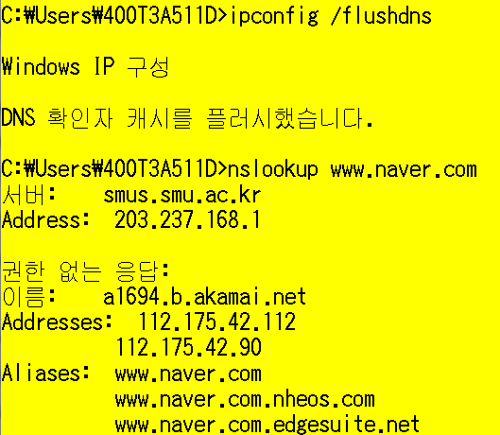
Lab 03-1: nslookup
Instructions & Questions
Use ipconfig to empty the DNS cache in your host.
  ipconfig /flushdns
Open a CMD window and Run “nslookup www.naver.com”
  권한 없는 응답이란 무엇인가?
  서버란 무엇인가?
  이름이란 무엇인가?
  Aliases란 무엇인가?
Notes:
위쪽 서버, address는 local DNS server의 서버 이름과 주소를 알려주고 있다.

Slide 4
Lab 03-2: DNS
Instructions
Use ipconfig to empty the DNS cache in your host.
  ipconfig /flushdns
Open your browser and empty your browser cache. (With Internet Explorer, go to Tools menu and select Internet Options; then in the General tab select Delete Files.)
Open Wireshark and enter “ip.addr == your_IP_address” into the filter, where you obtain your_IP_address with ipconfig. This filter removes all packets that neither originate nor are destined to your host.
Start packet capture in Wireshark.
With your browser, visit the Web page: http://www.ietf.org
Stop packet capture.
Notes:
Ipconfig /all

Slide 5
Lab 03-2: DNS
DNS query와 response message들을 확인하라.
Questions
Are they sent over UDP or TCP?
What is the destination port for the DNS query message? What is the source port of DNS response message?
To what IP address is the DNS query message sent? Use ipconfig to determine the IP address of your local DNS server. Are these two IP addresses the same?
Examine the DNS query message. What “Type” of DNS query is it? Does the query message contain any “answers”?
Examine the DNS response message. How many “answers” are provided? What do each of these answers contain?
Notes:
Ipconfig를 통해 나온 DNS 주소는 local DNS 주소이다.

Slide 6
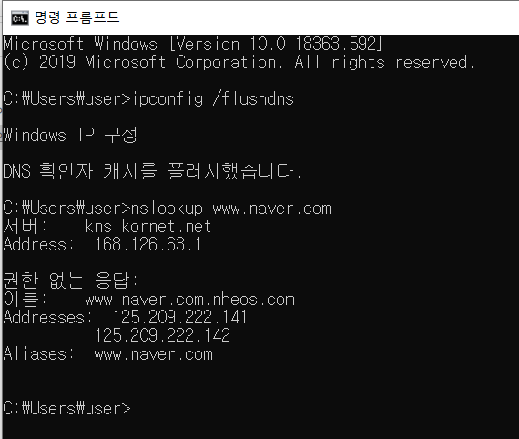
Lab 03-1: nslookup
  * 권한 없는 응답이란 무엇인가?
  권한 없는 응답, non-authoritative reply란 지정된 DNS 서버에 저장되어 있는 cache가 응답한 것이다. 보통은 local DNS server가 대부분 응답한다.
  서버란 무엇인가?
  ➔ 우리가 query로 요청한 곳인 DNS 서버를 의미한다. Local DNS server라고 보는게 좋을 것이다.
  이름이란 무엇인가?
  DNS 서버가 응답해준 해당 주소의 호스트 이름을 말한다.
  Aliases란 무엇인가?
  ➔ 가짜이름, 우리가 요청한 DNS record의 이른바 별칭, 가짜이름을 뜻한다.

Slide 7
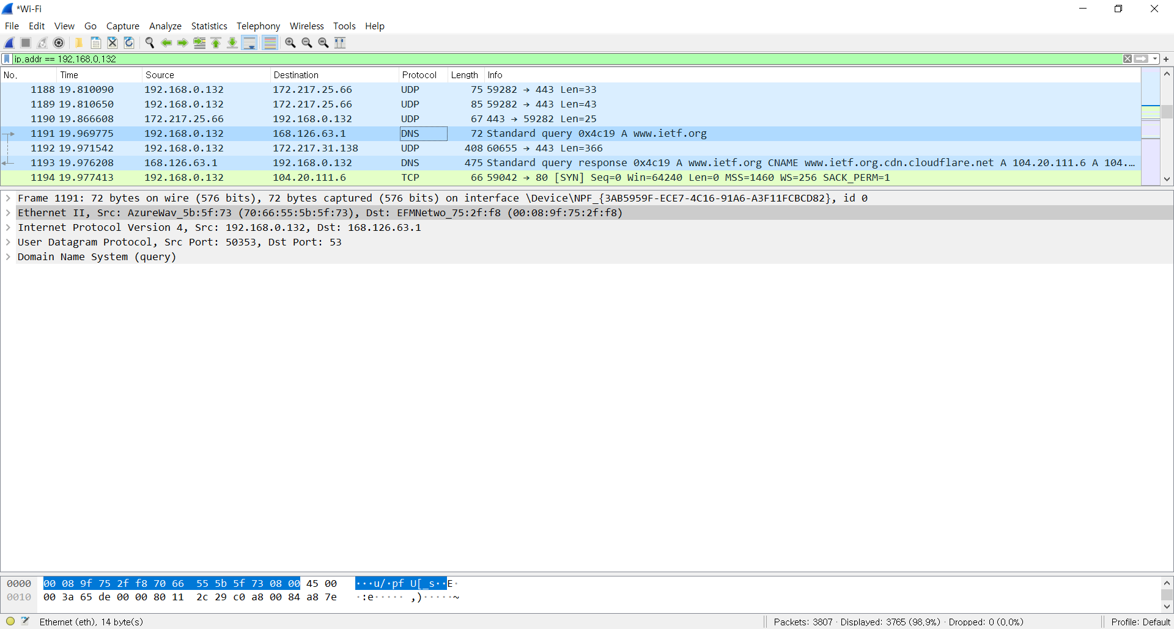
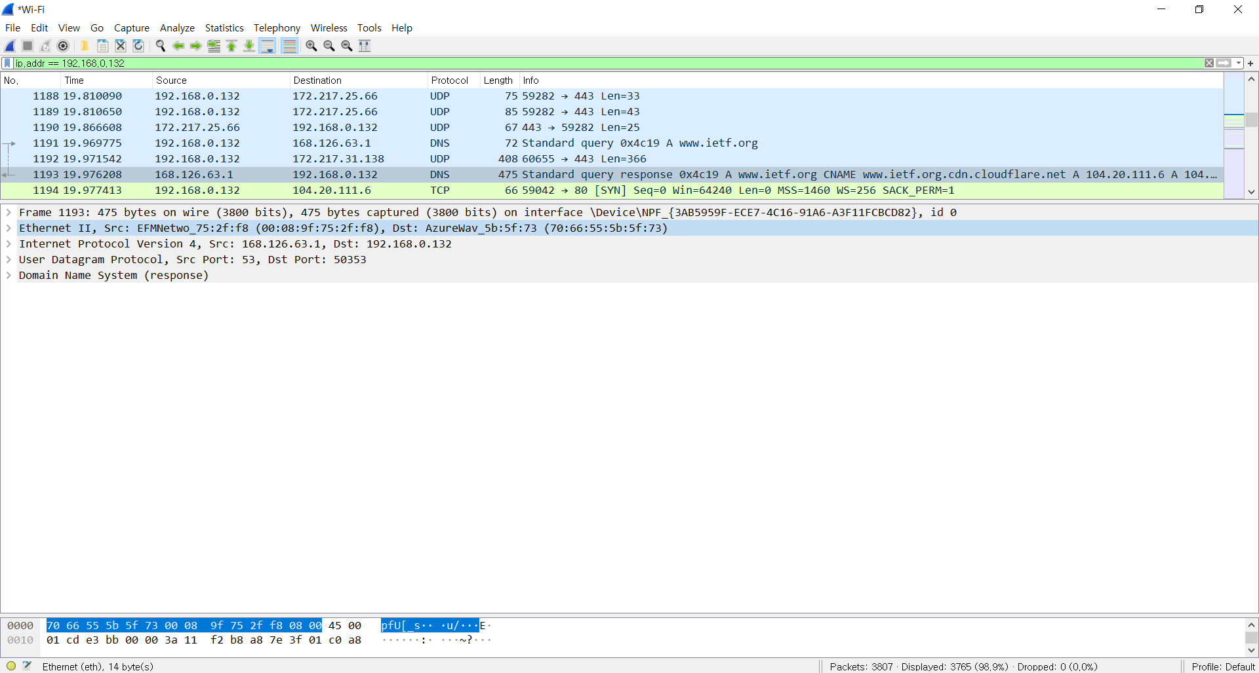
Lab 03-2: DNS
DNS query 전체 모습
DNS response 전체 모습

Slide 8
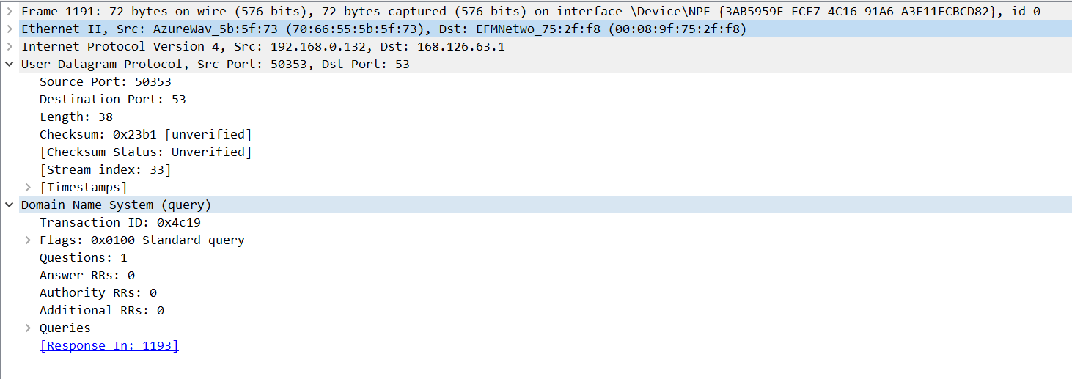
Lab 03-2: DNS
Are they sent over UDP or TCP?
➔ DNS(query) : UDP(User Datagram Protocol)를 이용해 보냄

Slide 9
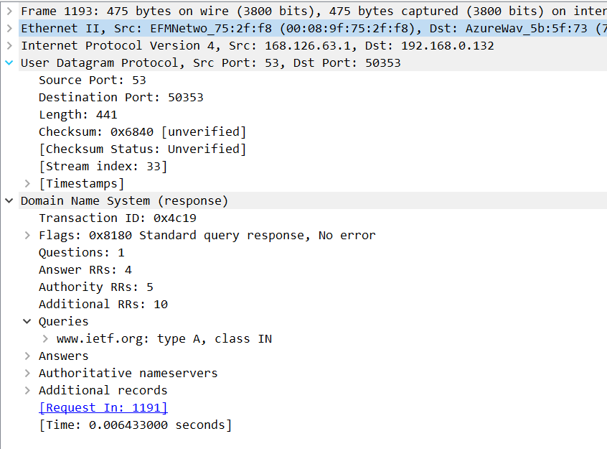
Lab 03-2: DNS
Are they sent over UDP or TCP?
➔ DNS(response) : UDP(User Datagram Protocol)를 이용해 보냄

Slide 10
Lab 03-2: DNS
2. What is the destination port for the DNS query message?
What is the source port of DNS response message?
➔ Destination port for the DNS query message: 53
Source port of DNS response message: 53
둘다 53이다.

Slide 11
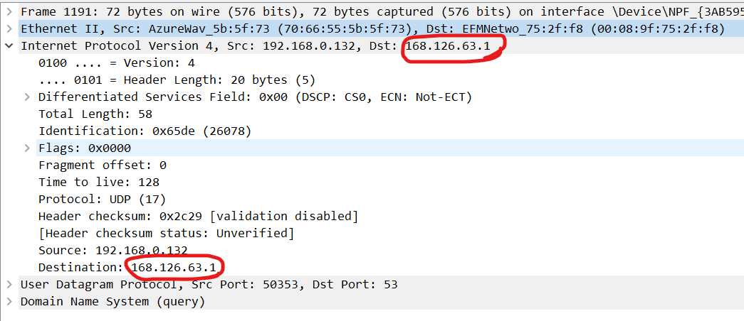
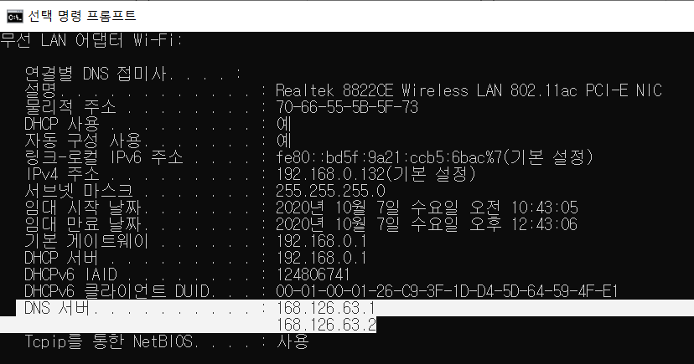
Lab 03-2: DNS
3. To what IP address is the DNS query message sent? Use ipconfig to determine the IP address of your local DNS server. Are these two IP addresses the same?
IP address(DNS query message sent): 168.126.63.1
Ipconfig를 통해 파악한 내 pc의 local DNS server: 168.126.63.1
두 개 다 같다는 것을 볼 수 있다.

Slide 12
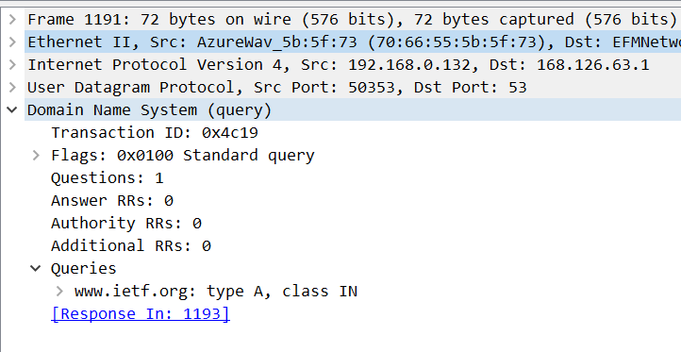
Lab 03-2: DNS
4. Examine the DNS query message. What “Type” of DNS query is it? Does the query message contain any “answers”?
“Type” of DNS query: A
Answers: 질문하는 것이기에 존재하지 않는다.

Slide 13
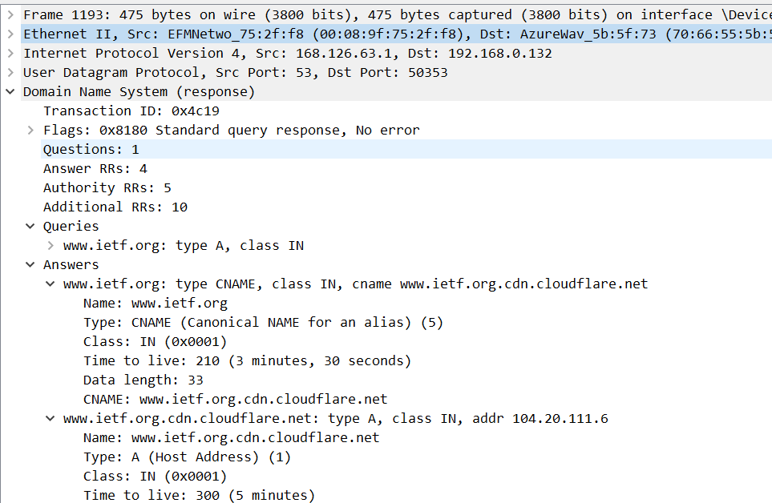
Lab 03-2: DNS
5. Examine the DNS response message. How many “answers” are provided? What do each of these answers contain?
➔ How many “answers” are provided: 4 (Answer RRs)

Slide 14
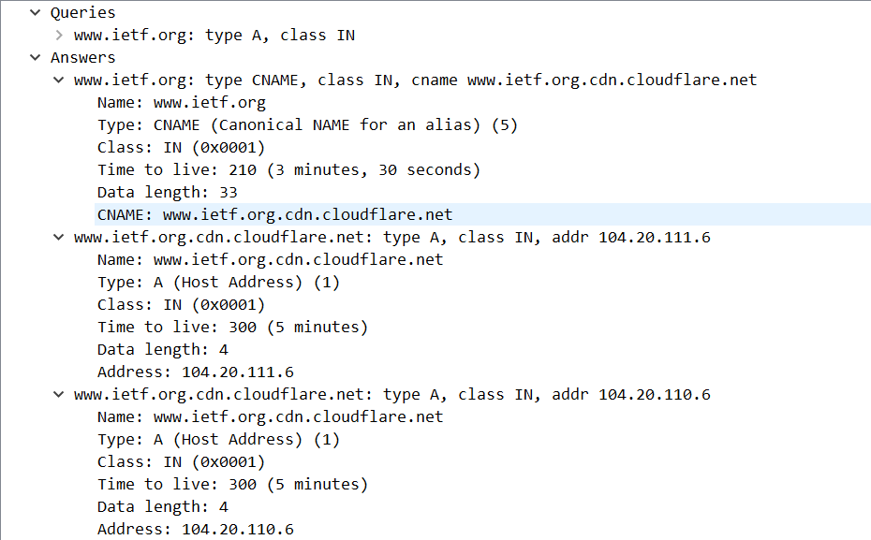
Lab 03-2: DNS
5. Examine the DNS response message. How many “answers” are provided? What do each of these answers contain?
Name
1.
Type(Canonical NAME for an alias)
Class
TTL(Time to live)
Data length
CNAME(Cononical name, 실제 이름)
2.
3.

Slide 15
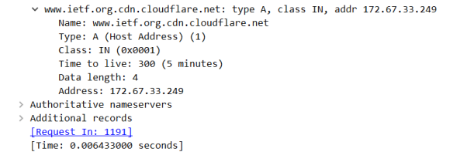
Lab 03-2: DNS
5. Examine the DNS response message. How many “answers” are provided? What do each of these answers contain?
4.

